Slide 1
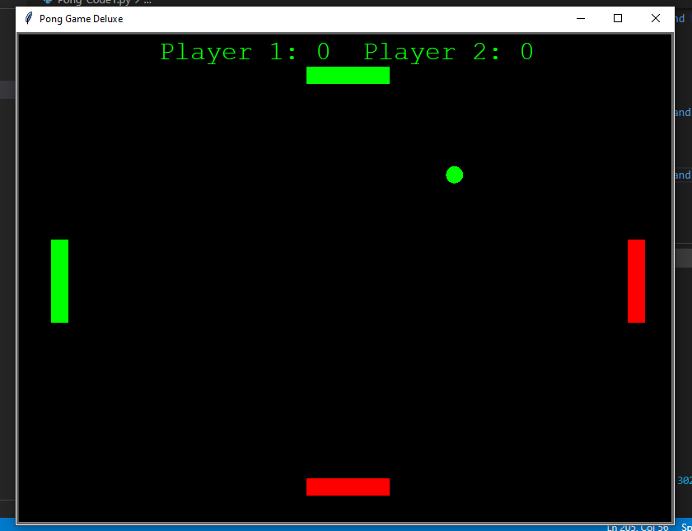

Pong Game “No Ball is too easy”
Original Coder: Joe S.
Updated by: Tj Martin & Taylor Harbin
Adding 4 player functionality to a classic arcade game.
https://github.com/ksu-is/pong-game.Fall2020

